Slide 1

Analog Electronics (EE061IU)
Textbook:
Microelectronic Circuits
Adel S. Sedra and Kenneth C. Smith, Sixth Edition
Link to download materials: http://blackboard.hcmiu.edu.vn
Instructor: Tran Van Su

Slide 2
Course Description
This course develops a basic understanding of the fundamentals and principles of analog circuits and electronic devices in electrical and electronic engineering. It covers differential and multistage amplifiers; frequency response; feedback, power amplifiers; filters and signal generators.
Requisite :
EE090IU – Electronic Devices
Co-requisite:
EE062IU: Analog Electronics lab

Slide 3
How course outcomes are assessed:
Homework Problem, Class attendance, and Quizzes (30%)
Mid-term exam (30%)
Final Exam (40%)
Homework problems are assigned bi-weekly collected and graded by teaching assistant (Nguyen Bang Dang Huy – nbdhuy@hcmiu.edu.vn)
Contact information:
Office hours: Tuesday morning, or by appointment @ O2.108
Contact information: tvsu@hcmiu.edu.vn

Slide 4
Course Objective:
To make sure students understand BJT, MOSFET.
To introduce students differential and multistage amplifiers; frequency response; feedback, power amplifiers; filters and signal generators.
Lecture Topics:
Introduction to Analog Electronics
Building blocks of Integrated Circuit Amplifiers
Differential and Multistage Amplifiers
Frequency Response
Feedbacks
Output Stages and Power Amplifiers
Filters and Tuned Amplifiers
Signal Generators and Waveform-shaping Circuits

Slide 5
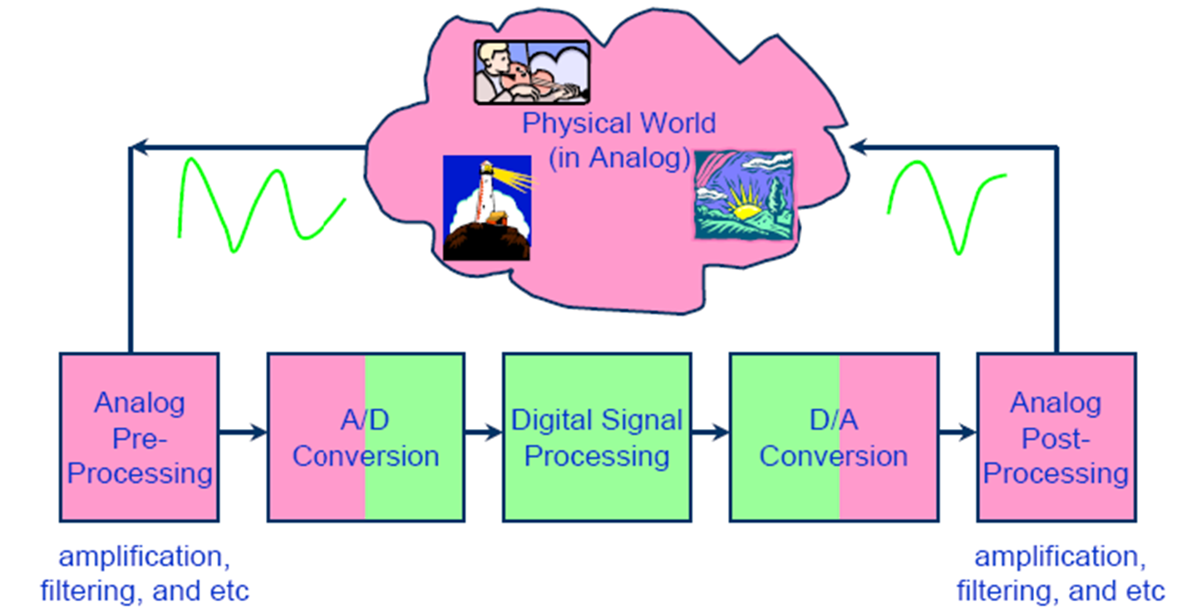
Lecture # 1: Introduction to Analog Electronics
Electronic circuits in modern systems

Slide 6
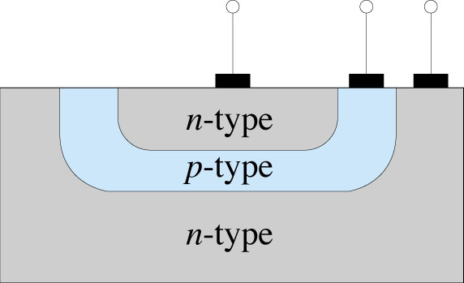
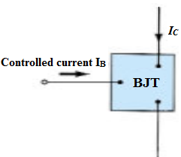
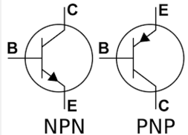
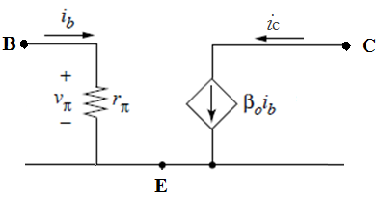
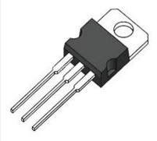
Bipolar Transistor (NPN-type)
The BJT (Bipolar Junction Transistors) is a three-terminal device (Collector, Emitter,Base) .
BJT transistor is a current-controlled device.
Equivalent circuit
6

Slide 7
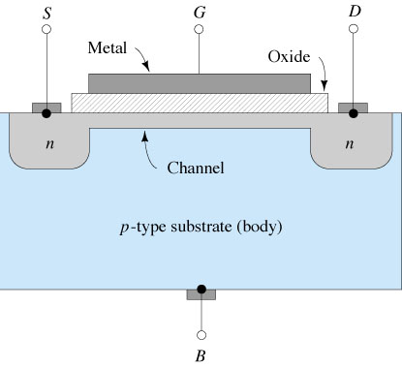
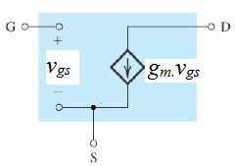
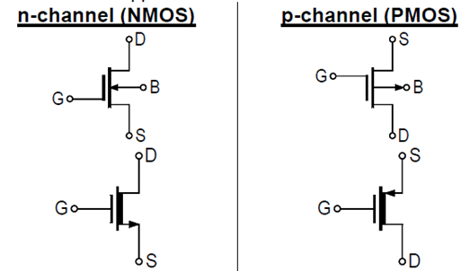
FET Transistor
The FET (Field-Effect
Transistor) is a three-terminal device (Drain, Gate, Source)
FET transistor is a voltage-controlled device.
Equivalent circuit
7

Slide 8
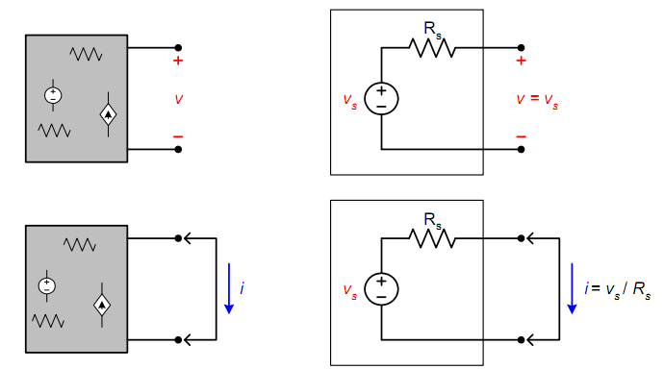
Source Transformations
Source transformations can be a useful way to simplify circuits
THEVENIN AND NORTON EQUIVALENTS
– Can represent any sources made up of sources (both independent and
dependent) and resistors
– Converting to a Thevenin equivalent
8

Slide 9
9

Slide 10
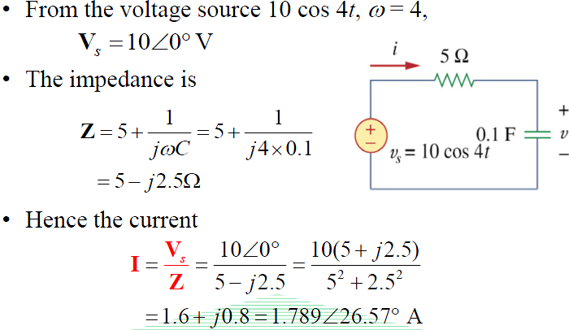
Example

Slide 11
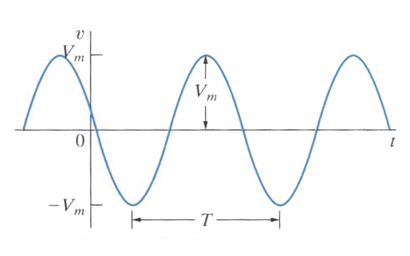
The Sinusoidal Signal
T : period of the function (s)
f : frequency of the function (Hz)
ω : angular frequency (radians/second)
Φ: phase angle (degree)
V_{m} : maximum amplitude (V)
V_{rms}: root mean square value
A sinusoidal voltage/current source produces a voltage/current that varies sinusoidally with time.
Ωt + Φ : the argument of the sinusoid

Slide 12
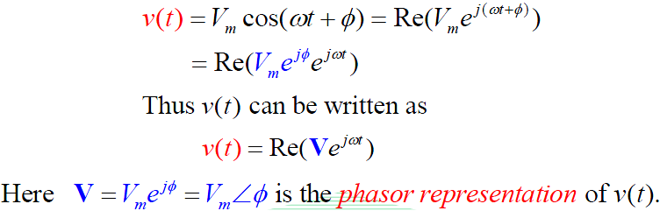
The Phasor
Euler’s identity:
For a given sinusoidal voltage function:
The phasor is a complex number that carries the amplitude and phase angle information of a sinusoidal function.
The phasor transform of the given sinusoidal function is:

